Slide 1

fast Fourier transform
Done By: Rifat Abuelenin

Slide 2
The problem description :
so the main problem in this project is to show the different memory model in multi-core and cluster-based systems i.e., multi-core systems have a shared-memory whereas in cluster-based systems, each processing element has its own local memory In fact, considering features of both memory models used in multi-core and cluster-based systems at the same time dramatically increases the programming complexity

Slide 3
Solution
So The solution is the skeleton fast Fourier transform so having this algorithm we can have high speed up and at the same time we can reduce the complexity as we mentioned earlier

Slide 4
Definition : A fast Fourier transform (FFT) is an algorithm that computes the discrete Fourier transform (DFT) of a sequence, or its inverse (IDFT). Fourier analysis converts a signal from its original domain (often time or space) to a representation in the frequency domain and vice versa.

Slide 5
Fast Fourier Transform Benchmark
So The Fast Fourier Transform (FFT) is a class of algorithms that have O(n log(n)) complexity that calculate the Discrete Fourier Transform of a sequence of floating point complex numbers. The FFT is typically calculated by using a divide-and-conquer approach. FFTs of large number of elements are usually calculated by decomposing the problems into smaller problem sizes and then recomposing the original result from the results of the smaller FFTs. The FFT can be decomposed using several strategies. Some are only suitable when the number of elements n is a prime number; others only apply to powers of 2; others to composed values;

Slide 6
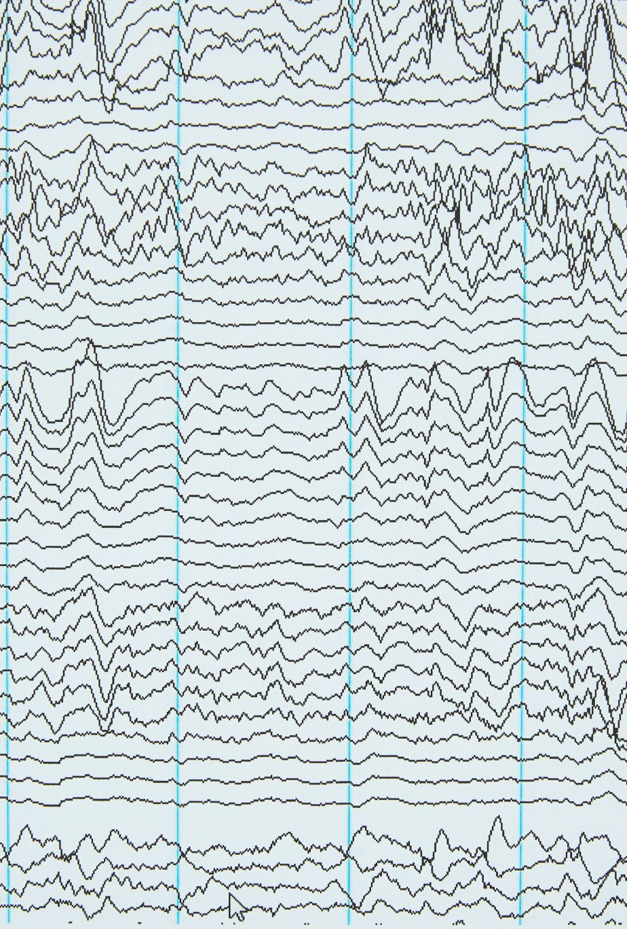
Fast Fourier transform Speed
The Speed of this algorithm running on time N log N, where N is the data size of the difference in speed can be enormous, especially for long data set where N maybe in the thousand or millions, many FFT are much more accurate than evaluating the DFT definition directly or indirectly.

Slide 7

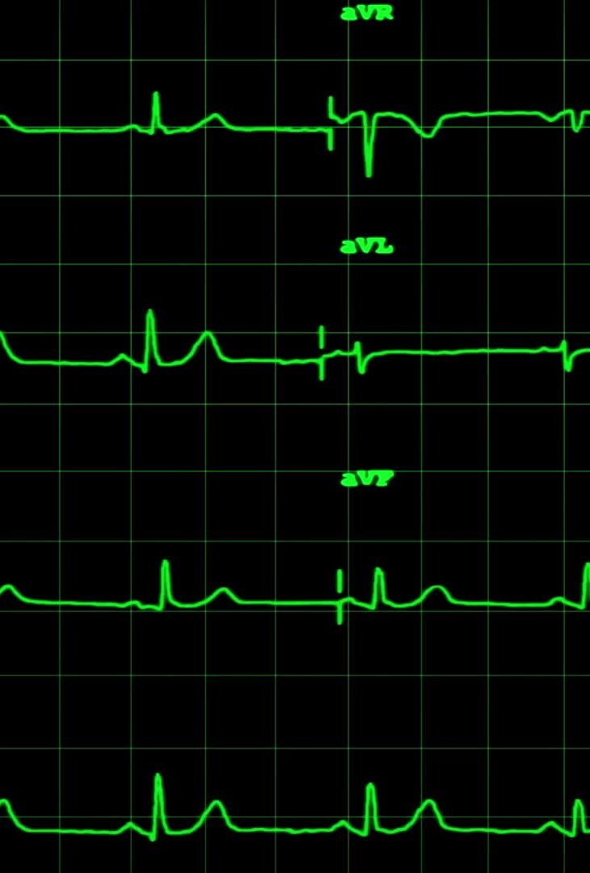
The Difference between DFT AND FFT
Discrete Fourier Transform (DFT) is the discrete version of the Fourier Transform (FT) that transforms a signal (or discrete sequence) from the time domain representation to its representation in the frequency domain and has running time O(N2). Whereas, Fast Fourier Transform (FFT) is any efficient algorithm for calculating the DFT.

Slide 8
Execution Time
Execution time goes down with the more processors that are being utilized. The exception is when number of processors is > 16. This is due to each node in the cluster that I used has 16 possible cores. When there is more than 16 processors the overhead of communication between nodes slows then execution down.

Slide 9
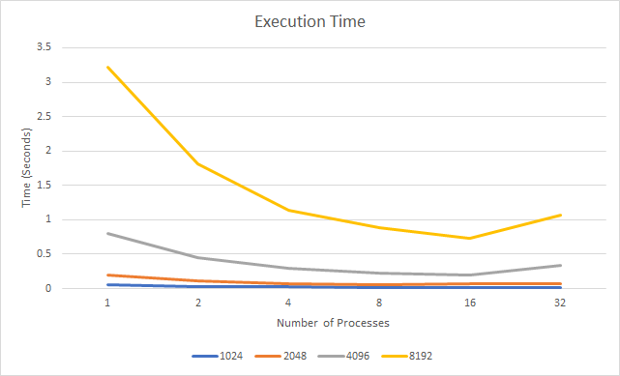
Execution Time

Slide 10
Speed-Up
Speedup is greatest when using the max amount of processes in a single node. In this case speedup is greatest using

Slide 11
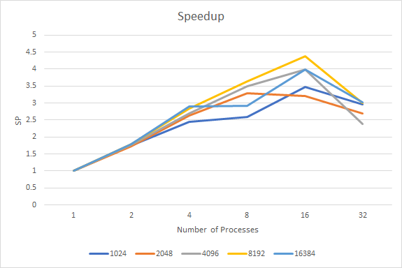
Speed-Up

Slide 12
Efficiency
Efficiency decreases in these examples due to the relatively small size of the problem. In this case problem size never goes beyond 16384. Efficiency decreases due to each process spending more time waiting than computing. If the problem size was bigger then efficiency would increase due to each process spending more time computing than

Slide 13
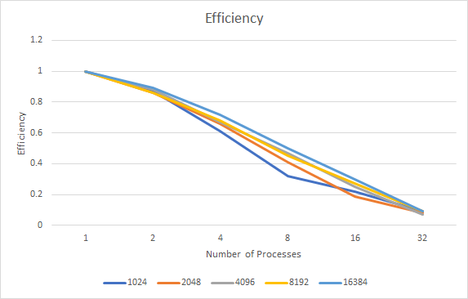
Efficiency

Slide 14
Used Of Fft
The FFT is used to process data throughout today’s highly networked, digital world. It allows computers to efficiently calculate the different frequency components in time-varying signals—and also to reconstruct such signals from a set of frequency components. The Fourier series has many such applications in electrical engineering, vibration analysis, acoustics, optics, signal processing, image processing, quantum mechanics, econometrics, shell theory, etc.

Slide 15
How can increase our skeleton program performance and decrease the complexity
So to do that we have three mechanisms
work stealing, each processing unit has its own queue of tasks to process. Whenever a processing unit completes them, it tries to steal more tasks from another processing unit. Each new task created is added to its own queue. This scheduling method is particularly interesting in applications where parallelism is expressed by the creation of recursive tasks.

Slide 16
Work stealing
For instance, this figure shows a recursive algorithm of the transform problem where each call to the transform() method generates a new task that can be executed in parallel. Work stealing is an efficient way to schedule such applications
transform( input, output, N, F) {
if (N<2)
output[0] = F(input[0])
Else
{
transform( input, output, N/2, F)
transform( input+N/2, output+N/2, N-N/2, F);
}
}

Slide 17
Methods used in work stealing
This structure is accessed by three different methods: Push, Pop and Steal (Figure 4.3). The push operation is called by the thread to add a new task to its own work queue. This operation is always non-blocking and decrements the begging index. The Pop operation is used to get a new task from its own work queue. When there are no more tasks on the thread’s own work-queue, it uses the steal operation to get tasks from other threads. The pop operation is non-blocking in the general case, the exception occurs when another thread tries to steal the same task being popped Steal operation are always blocking and removes tasks from the end of the work queue by decrementing the end index.

Slide 18
communication/computationoverlappin mechanism
Overlapping computation with communication, or latency hiding, has long been recognized as an effective technique for masking data transfer latency, with the potential for considerable performance gains, enabling applications to scale well on large numbers of processors The degree of actual overlap for an application depends on the overlap potential of both the application and the underlying communication subsystem. Fundamentally, the communication system must provide the means to return control to the calling application while some or all of the communication operation takes place in the background. In turn, the application must be written to exploit this capability, both by using the appropriate part of the communication system’s API and by structuring code to maximize overlap. MPI has been the most popular standard for developing parallel scientific applications. The MPI interface includes non-blocking point-to-point calls (i.e. MPI Isend, MPI Irecv) which allow the separation of initiation and completion of message transfers. Additionally, even with blocking operations, the system can transparently

Slide 19
communication/computationoverlappin mechanism
The experiments were conducted using a cluster at the Ohio Supercomputer Center. Each compute node has 4GB RAM and two Intel 64 bit processors running Linux 2.4.21-sgi306rp21 OS. There are two partitions of compute nodes, one with 900MHz processors, and second with 1.3 GHz processors. The nodes are connected by 2 Gbit/s Myrinet high speed interconnects, using Myrinet 2000 C or D NICs on the 64-bit 133MHz PCI-X buses. The driver version is GM-2.1.4. All codes including libraries and test codes were compiled using Intel 8.0 suite of optimizing compilers with -O3 flag. Our experiments were run with one MPI process per dual-processor node in order to test communication across the network. The gm allsize utility provided with GM drivers was used a priori to characterize data transfer times for various message sizes.

Slide 20
Overlapping
Many parallel algorithms apply some kind of element-wise transformation or computation to large (potentially multi-dimensional) data sets. Sancho et al. show several examples for such “Concurrent Data Parallel Applications” in [39] and prognose a high overlap potential. Other examples are Parallel Sorting [11], Finite Element Method (FEM) calculations, 3D-FFT [2] and parallel data compression [40]. We chose a dynamic, data-driven application, parallel compression, as a more complex example than the simple static-size transformations that were shown in previous works. The main difference here is that the size of the output data can not be predicted in advance and strongly depends on the structure of the input data. Thus, a two-step communication scheme has to be applied to the problem. In our example, we assume that the N blocks of data are already distributed among the P processing elements (PE) and each PE compresses its blocks by calling compress(). The data will finally be gathered to a designated rank. Gathering of the compression results must be performed in two steps where the first step collects the individual sizes of the compressed data at the master process, and determines so the parameters of the second step, the final data gathering. This naive scheme is shown in Listing 1.

Slide 21
architecture-aware macinasm
A primary contribution is to develop and evaluate new high-level architecture-aware programming constructs for hierarchical parallel platforms. So . One salient feature of multi-core architectures is that they have a varying degree of sharing of caches at different levels. With the advent of multi-core architectures, we are facing the problem that is new to parallel computing, namely, the management of hierarchical caches.

Slide 22
Map overlap
The functionality of Map Overlap is similar to Map in that it applies a user-function at every index of a container, but it follows a very different accessing pattern. While Map allows for multiple containers, Map Overlap does not. SkePU’s Map does allow for random access whereas Map Overlap only allows for accesses to elements which are within the same neighborhood. As a stencil operation Map Overlap must define a range and declare that all indexes within this range are neighbors, these are the only elements the user-function may access. This trades off the user-friendliness of the random access for the ability to handle tasks which have too strict data dependencies to be used by Map

Slide 23
Map overlap

Slide 24
Fft Array
The array to which the Fast Fourier Transform should be applied. If Array is not of complex type, it is converted to complex type. The dimensions of the result are identical to those of Array. The size of each dimension may be any integer value and does not necessarily have to be an integer power of 2, although powers of 2 are certainly the most efficient.

Slide 25
Split Method
HERE WE CAN SPLIT THE EVEN AND ODD NUMBER USING DATA TYPE DOUBLE WITH COMPLEX

Slide 26
PARALLEL TIME IN FFT ALGORTHIM
THERE ARE N TASKS AND LOGN STAGES SO PARALLEL TIME REQIURED
TO COMPUTE FFT IS TN=(TC+TS+TW)LOGN,WHERE TC IS COST MULTIIBLY-ADD ,AND TS+TW IS COST OF EXHANGING ONE NUMBER BETWEEN PAIR OF TASK AT EACH STAGE .

